Slide 1
Sugon Disk System DS600-G20 Overview
Storage Product Department

Slide 2
Contents
1
Overview
2
Characteristic
Notes:
先讲整个IT行业的大背景

Slide 3
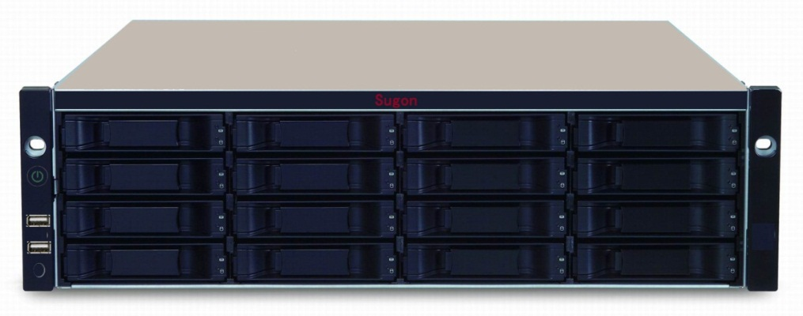
Product Features and Highlights
SYSTEM & CONTROLLER
64bit 6-core @ 1.1GHz Processor
Standard 2GB cache per controller (up to 16GB)
Fiber Channel 8Gbps, iSCSI 1Gbps & 10Gbps host connect ports
Dual Controller High Availability Design
High Scalability (112 HDDs) and Green Design
DATA PROTECTION
Predictive Data Migration (PDM)
PerfectRebuild - Rebuild with improved recovery efficiency
Advanced battery flash backup
Online LUN clone (available in SR1)
Hard disks cache backup (available in SR3)
NAS function
CIFS (MAC, Windows), NFS (Linux/Unix) Protocol
Permission Management, Quota Management, Online Expansion
MANAGEMENT & OPERATION
Power button and power resume management
PerfectFlash™ -Non-disruptive image update without system downtime
Built-in performance monitor and power usage monitoring
OPAS Service Log and UPS Monitor through USB
Support Wake-on-LAN and Wake-on-SAS
Mute alarm control
Notes:
先讲整个IT行业的大背景

Slide 4
System Management
Embedded WebPAM PROe management console
CLU & CLI via RJ-11 or Ethernet port
SLP, Telnet, SSH, SNMP, NETSEND
Real Time Clock (RTC), Network Time Protocol (NTP)
E-mail notification for critical events
Green Power Schedule
Wake on LAN & Wake on SAS
Front side USB OPAS
Rear side USB and Ethernet UPS
Power button and power resume management
Mute alarm button
Notes:
先讲整个IT行业的大背景

Slide 5
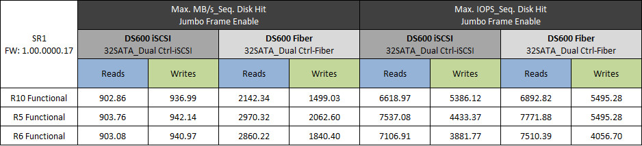
Performance at a Glance
iSCSI Max. Throughput
Fiber Max. Throughput
Notes:
先讲整个IT行业的大背景

Slide 6
DS600-G20 Hardware Frame
UART x 2
UART2
UART1
RJ45
10/100 PHY
JBOD Ext
SAS
2/4GB ECC DDR1333
SGPIO
CPLDs
USB
PCIe Connector
USB
LSI SAS6G
LSI SAS
Expander
SAS
HDDs
XAUI
1.1GHz
6-cores
RTL 8214
PCI-1
PCI-2
I2C-1
PSU1/2, FAN1/2 BBU
FC-8G
PCI
Bridge
USB 1
FC8G
C2C-2
I2C-2
PCIe Connector
USB-2
RTC
WinBond
EEPROM
GPIOs
256KB
NVRAM
128 MB
SLC Flash
CPLD
USB Flash
8GB
Option
Notes:
先讲整个IT行业的大背景

Slide 7
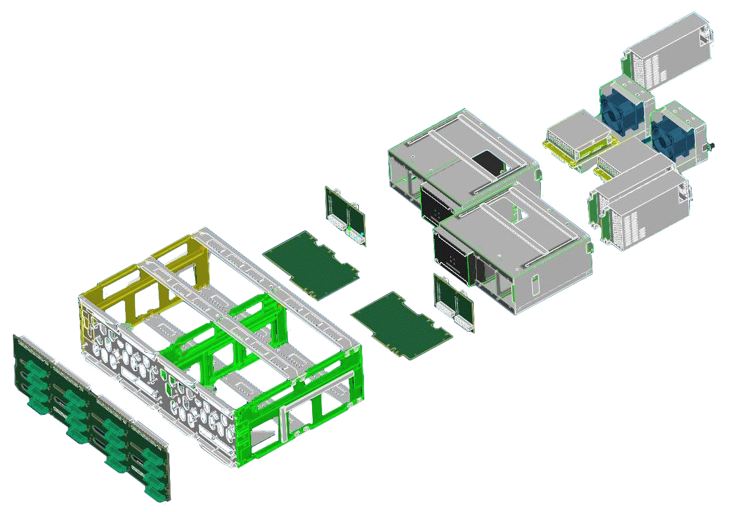
DS600-G20 Modular architecture
FAN/BBU
Controller Chassis
Controller
Chassis
Backplane
N+1 Power Supply
Power supply board
Notes:
先讲整个IT行业的大背景

Slide 8
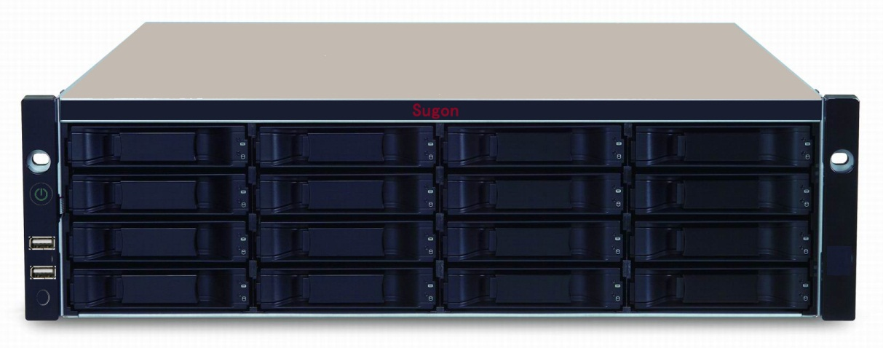
DS600-G20 Front view
Disk power
Power
Disk state
Chassis state
Intelligent switch
RAID state
Mute
IPMI
Controller state
System state
Heartbeat state
Notes:
先讲整个IT行业的大背景

Slide 9
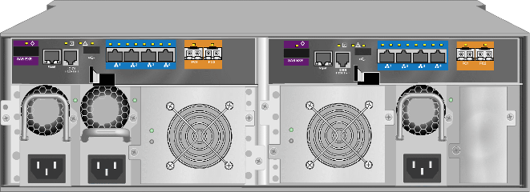
DS600-G20 Rear view
Management of serial port
UPS interface
Controller 1
Management interface
ISCSI host port
Expend interface
FC host port
Power Supply
FAN/BBU
3+1 PowerSupply(Optinal）
Notes:
先讲整个IT行业的大背景

Slide 10










Multi protocol topology
Clients
LAN/WAN
FC SAN Application Servers
iSCSI SAN Application Servers
CIFS/NFS
FC Switch
GbE Switch
Notes:
先讲整个IT行业的大背景

Slide 11


DS600-G20 PRAID technoloy
Innovative RAID array rebuild approach
  Ignores LD portion where no write changes have occurred, only focuses on parts that have changed
  Greatly reduces the amount of time needed for completion
  Frees up CPU resources more quickly for I/O and other demands
Controller NVRAM
Failed Drive
NVRAM
LUN 0, RAID10
LUN 1, RAID5
Rebuild
LUN 2, RAID6
Host Server
Vess R2000
RAID Arrays
Spare Drive

Slide 12
DS600-G20 PRAID principle
Cell1
LUN1
Cell2
Cell3
Cell4
CellN
disk1
disk2
disk3
disk4
disk5
disk6
disk7
disk8
RAID
Cell1
Cell2
Rebuild
Cell3
Cell4
CellN
disk1
失效
disk3
disk4
disk5
disk6
disk7
disk8
Hot spare
RAID

Slide 13
Perfect Rebuild vs. Normal Rebuild
In order to more clearly illustrate the advantage of the Perfect Rebuild feature, here is a test result that compares the time required for a full rebuild to the time required for Perfect Rebuild using different sized LUNs and different levels of LUN capacity utilization.
LUN Capacity | LUN Usage | Time required |  | % Improved
 |  | Full rebuild | Perfect Rebuild
250GB | 25% | 67m 56s | 16m 20s | 416%
500GB | 50% | 68m 13s | 34m 17s | 198%
750GB | 75% | 68m 22s | 49m 57s | 137%
Note: The results listed here were from a test setup using Windows Server 2008 R2 Enterprise (Full Installation) 64bit SP1 (OS size: 8GB)

Slide 14




Advance Battery Flash Backup
Host Serves
How it works
  Uses power from the BBU module to save write cache data to non-volatile NAND flash memory
  Keeps RAID controller write cache data for years beyond the standard 72 hours data retention period provided by a typical BBU
  Provides same function at a lower cost level compared to competitive SuperCapacitor design
DDR3
Flash Backup Module
Controller FRU
BBU
Disk Arrays

Slide 15

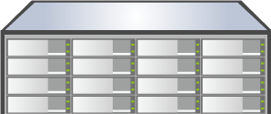
DS600-G20 Online LUN Clone
  Online LUN cloning, do not need to take the host resources
  Automatically synchronize, without manual intervention
  Support 1 to 1, 1 to the multi volume clone
SERVER
DS600-G20
DS600-G20-JBOD
LUN 0, RAID10
LUN 3, RAID10
SERVER
LUN 1, RAID5
LUN 4, RAID5
LUN 2, RAID6
LUN 5, RAID6
Source LUN
Target LUN

Slide 16
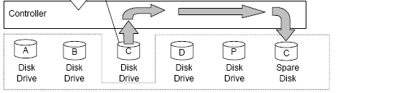
Predictive Data Migration
Predictive Data Migration， When certain conditions are met, the data will pre migration to hot spare disk, the maximum to avoid data loss.
Patrol Media, automatically detect physical disk status， if encounter bad block or other errors，Patrol Media feature will automatically launch Data Migration.
Predictive Media Patrol can be to manually, but also can be automatic cycle operation.

Slide 17
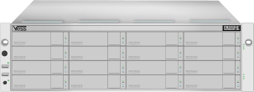


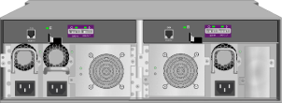
Power Resume Management
OFF
HW detect power up
  RAID and JBOD unit
SW control power down
  Press 5 seconds and release
  Arrays graceful shutdown
  LED indicator for power down
Power resume management (CLI)
  Always on
  Always off
  Last state (default)
ON
OFF
ON
OFF
ON
OFF
ON
OFF
ON

Slide 18
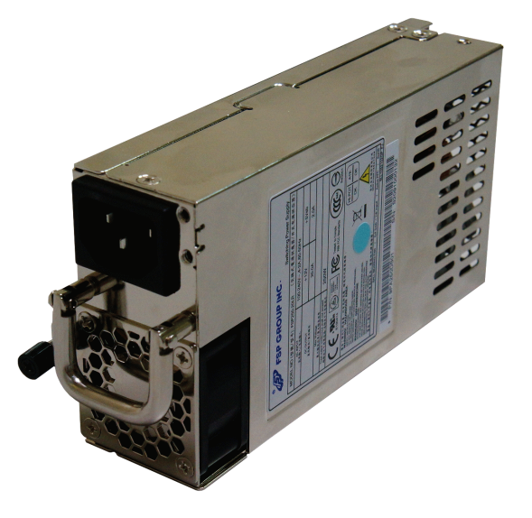

DS600-G20 80 PLUS Bronze
Efficiency
Save electric energy up to 21%
Load

Slide 19
Intelligent Power Management MAID 2.0
Normal
Concept
  The disk array system can sleep according to the strategy, wake the sleep disk
Vaule
  When the disk is in sleep mode,the energy consumption can reduce 80%.
First Stage
Head Stop
10-20%
Save energy
Second Stage
Reduce Speed
30-40%
Save energy
Third Stage
Stop Rotation
60-70%
Save energy
Notes:
A stepwise process is taken to walk down the different levels of power stages.
These steps are user configurable and can be skipped entirely if the user decides to do so.
These idle time needed to trigger each power level is based on a system-wide setting, however, it can be disabled on an array basis.
Power savings are approximate and are the estimated savings from the Active state.

Slide 20










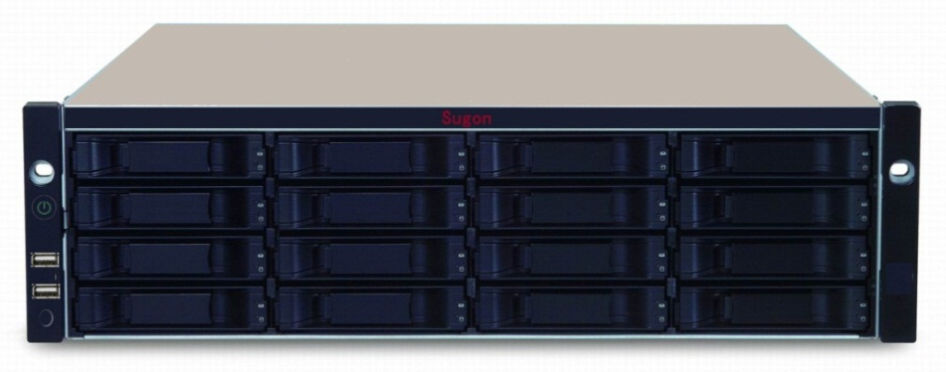
DS600-G20 OAPS
Log extraction
Automatic FW
updata
Automatic
deployment
Password reset
Firmware: 1.08.0000.00
Storage access with array config. and navigation.
Firmware: 2.04.0000.00
The username or password
you entered is incorrect.
.

Slide 21
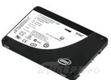
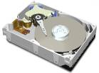

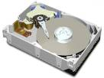
DS600-G20 multiple disk drives
SSD
SATA 6Gb
Capacity
480GB
…….
120GB
SAS
(10000 rpm)
SAS 6Gb
Capacity
1200GB
…….
300GB
SAS/SATA (7200rpm)
SAS 6Gb
Capacity
6TB
……
2TB

Slide 22
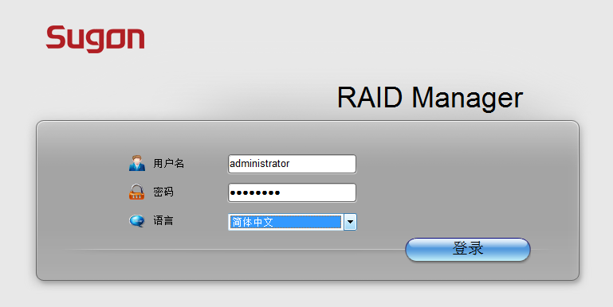
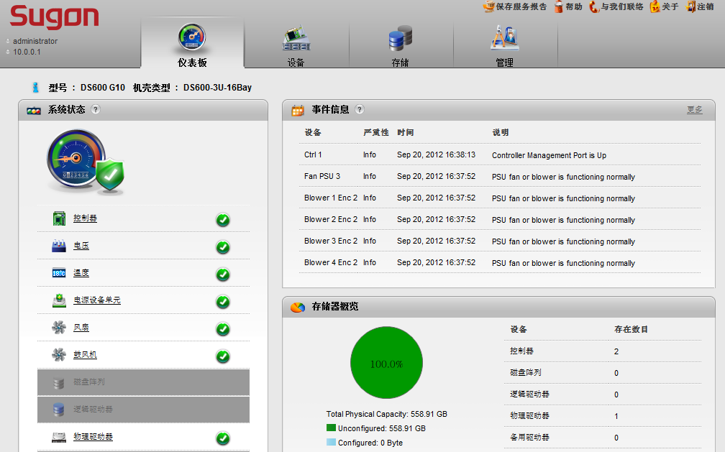
DS600-G20 management tool
Manage and configure
Supports importing configuration scripts
Extensive subsystem health and performance monitoring tools
Wide browser support
Localized in 10 languages
Notes:
WebPAMPROe
* Graphical Performance monitoring feature
* Supported by all major browsers – Internet Explore, Firefox, Safari
22

Slide 23
DS600-G20 Redefined Dashboard
系统监控
详细日志信息
系统状态监控
系统配置概况
Notes:
Dashboard view allows for a bird’s eye view of the subsystem and quickly indicates health of subsystem w/o having to view multiple pages.
23

Slide 24
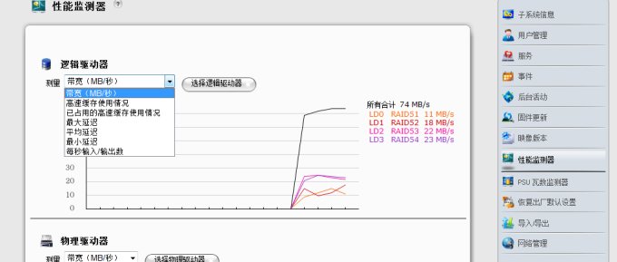
DS600-G20 Performance Monitor
Logical drive, physical drive and port monitoring
Monitor bandwidth, IOPs, latency and cache usage
No performance impact while monitoring
Notes:
24

